Slide 1


MULTILINGUAL SOCIAL MEDIA ANALYTICS
Understanding the impact of social media across different languages is crucial in today's globalized world. It involves analyzing, extracting, and interpreting data from various social media platforms in different languages.

Slide 2

TEAM MEMBERS
Asha Jyothi - 21JN1A4514
Lakshmi Prasana - 21JN1A4515
Kavya - 21JN1A4510
Harini - 21JN1A4504
Thanuja - 21JN1A4502
Suseela - 21JN1A4581
Devi - 21JN1A4566
Durga Devi - 21JN1A4550

Slide 3

INTRODUCTION
1
Global Reach
Multilingual social media analytics enables organizations to reach diverse audiences and understand their preferences and behaviors.
2
Cultural Insights
It provides valuable insights into cultural nuances, allowing for targeted and culturally sensitive marketing strategies.
3
Competitive Advantage
By analyzing multilingual social media data, businesses can gain a competitive edge by understanding regional trends and sentiments.

Slide 4
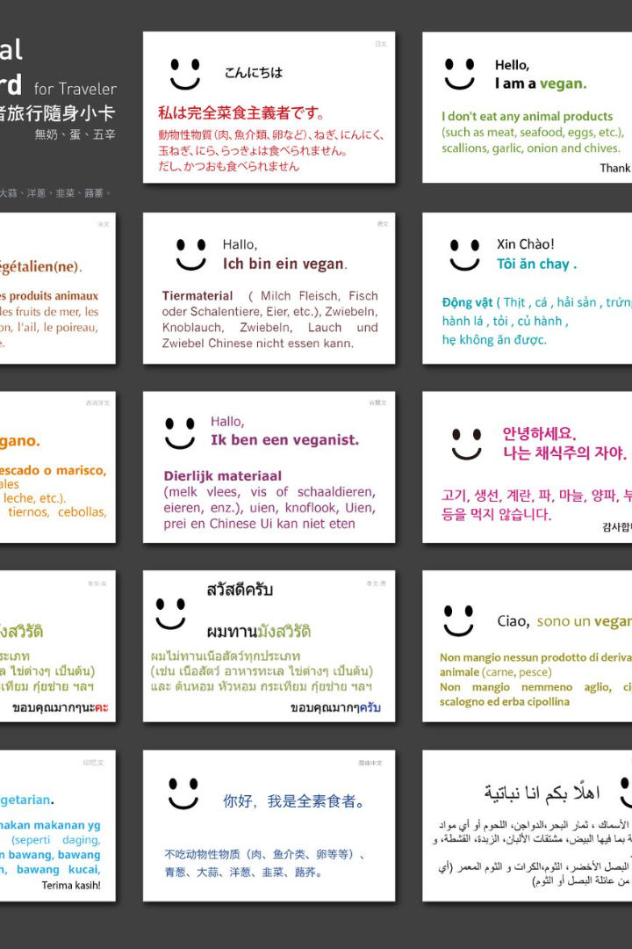



IMPORTANCE
Global Audience
Reaching international audiences and understanding their engagement is key for expansion and growth.
Cultural Relevance
Understanding cultural contexts and language nuances helps in crafting more impactful messaging and content.
Market Insights
Analyzing multilingual social media data provides insights into regional market trends and consumer behaviors.

Slide 5
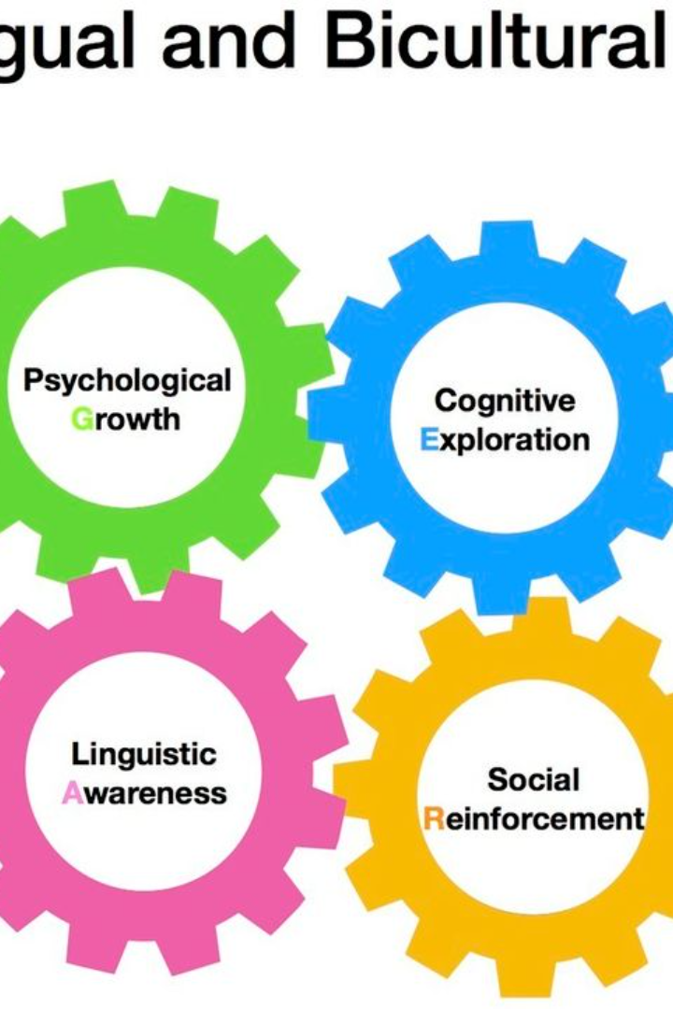
CHALLENGES
Linguistic Complexity
Data
Volume
Cultural Sensitivity
Dealing with varied linguistic structures and nuances requires advanced language processing algorithms.
Handling large volumes of multilingual data from diverse regions and platforms can be overwhelming.
Interpreting content accurately within its cultural context is a significant challenge in multilingual analysis.

Slide 6

Tools and Techniques for Multilingual Social Media Analytics
1
NLP Algorithms
Natural Language Processing algorithms enable sentiment analysis and language-specific data interpretation.
2
Language Detection APIs
Application Programming Interfaces for language detection assist in categorizing and organizing multilingual content.
3
Cultural Proficiency
Utilizing professionals with cultural expertise to accurately interpret content and sentiments in different languages.

Slide 7

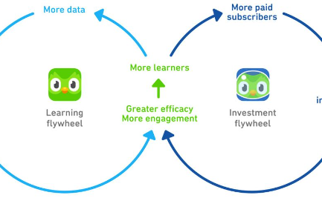

Case Studies of Successful Multilingual Social Media Analytics
Brand Campaigns
Market Expansion
Engagement Strategies
Successful utilization of multilingual analytics for targeted and impactful global marketing campaigns.
Real-world cases of companies expanding into new markets based on insights from multilingual social media data.
Case studies showcasing enhanced engagement through culturally relevant multilingual content.

Slide 8
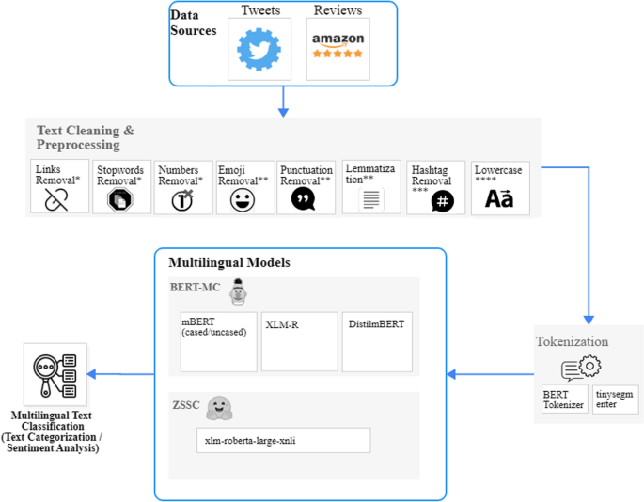
Best Practices for Conducting Multilingual Social Media Analytics
Data Quality
Ensuring accurate multilingual data collection and relevant data sources for reliable insights.
Cross-Cultural
Collaboration
Promoting collaboration between language experts and analytics professionals for holistic insights.
Localized Content
Creating region-specific, culturally sensitive content to enhance engagement and brand perception.

Slide 9

FUTURE TRENDS
AI Advancements
1
Integration of advanced AI technologies to facilitate real-time multilingual analysis and decision-making.
2
Language Agnostic Tools
Development of tools that can seamlessly process and interpret multiple languages without the need for language-specific configurations.
Hyper-Personalization
3
Utilizing multilingual data to personalize content and interactions at a hyper-local level for global audiences.

Slide 10
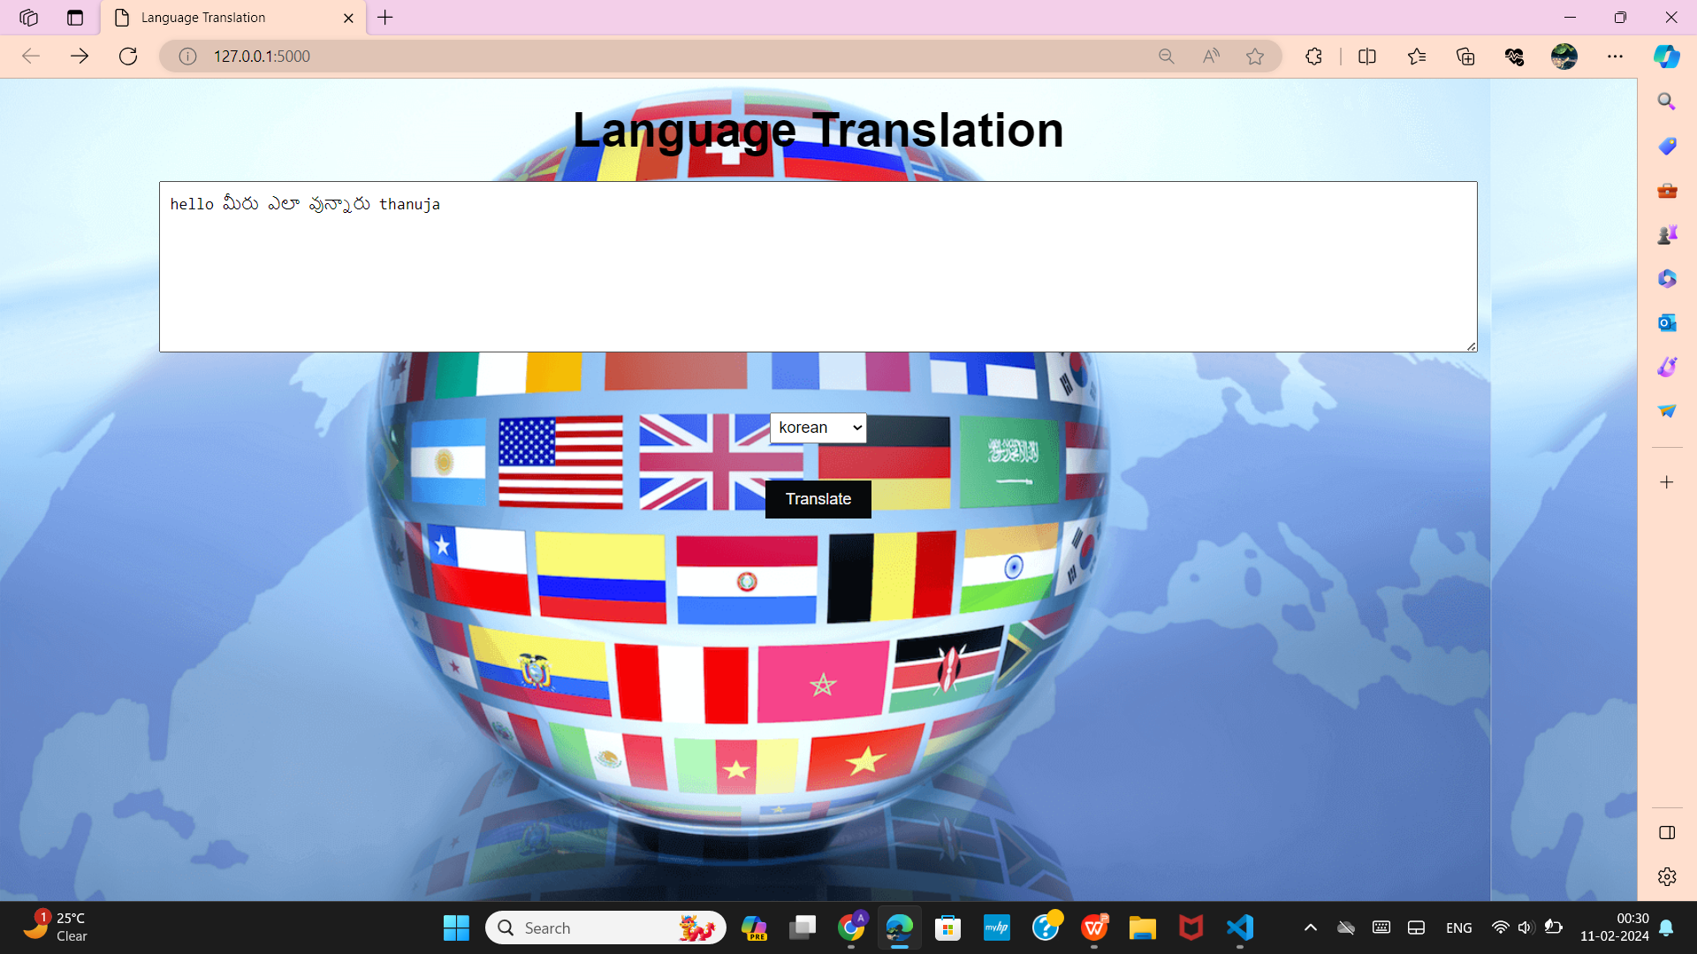
Our Code Input page

Slide 11
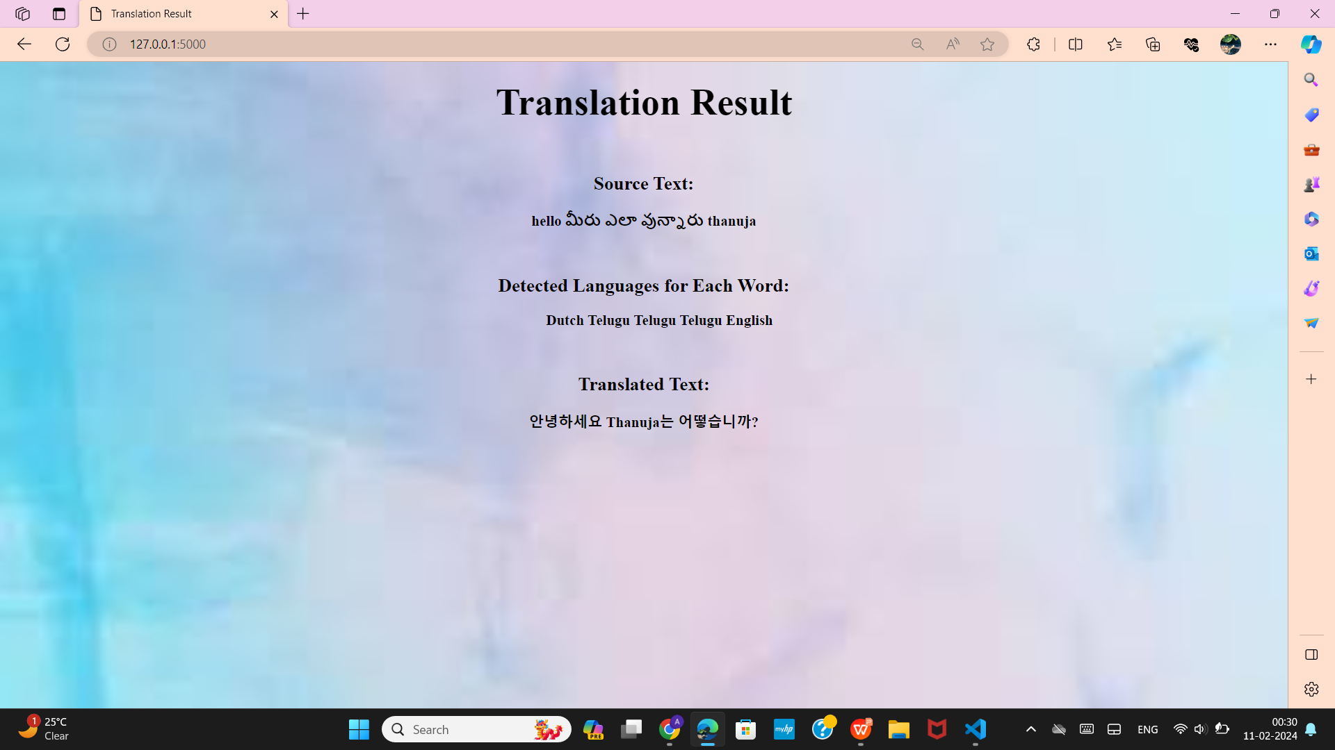
Our Code Output page

Slide 12
CONCLUSION
Diverse Insights
Growth Opportunities
Continuous Evolution
Multilingual social media analytics provides valuable, diverse insights essential for global strategies and market expansion.
Identifying and leveraging growth opportunities in diverse regions through comprehensive multilingual analysis.
Recognizing the need for continuous evolution in tools and techniques to adapt to changing global dynamics.

Slide 13
THANK YOU

